Slide 1

TEAM-DREAMFLOW
Project Name -Postify.Ai
Project Theme-Artificial intelligence
Member Details
Vishal Shukla (Leader)
Archit Tiwari
Vidit Jain
Harshdeep Singh

Slide 2


PROBLEM STATEMENT
With the Rapid growth of Social media, businesses and content creators struggle to generate engaging content and maintain a consistent posting schedule. Manual content creation and posting can be time-consuming, leading to inefficiencies in social media management.
Solution
We’ve built an AI-powered content creation platform designed to help individuals and businesses create and publish content faster and more efficiently.
Our platform offer Content Generation for more than 10+ templates including social media posts, blogs, YouTube scripts, programming tools and many more other.
You can effortlessly generate content using our templates and autopost it directly to your social media platforms—all from within our application.
No manual copy-paste—just Generate your content and post it directly in one click.
Enabled users to create and publish AI-generated Content directly on these platform 5× faster compared to manual workflows, significantly improving productivity.
We also offer an auto-scheduling feature that lets you schedule Generated content to be posted whenever you want—totally hands-free.

Slide 3
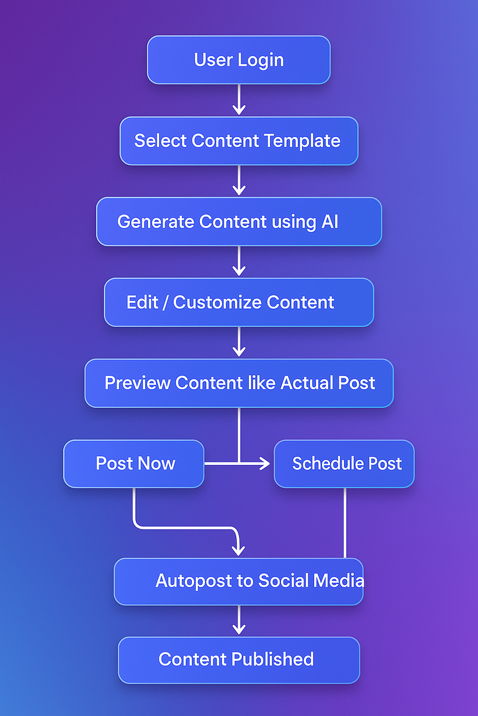
Work-Flow Diagram
AI-Powered Content Creation & Autoposting System
User Login
The user accesses the application and logs in using their credentials to begin the content creation
process.
Select Content Template
The user chooses from a variety of templates, such as for Instagram posts, LinkedIn content, YouTube
scripts, blogs, or programming tools.
Generate Content Using AI
With one click, AI models (like Google Gemini) generate high-quality written content based on the selected
template and any user inputs.
Edit / Customize Content
The generated content is shown in an editable interface where users can fine-tune the text, images, or
structure as needed.
Preview Content Like Actual Post
The platform provides a live preview so users can see exactly how the content will appear on the
respective platform.
Choose Any Post
The user selects which content to post immediately or schedule for later from a list of generated/edited
drafts.
Post Now (Option 1)
The content is immediately published to the selected social media platform (e.g., Instagram or LinkedIn)
using the autoposting integration.
Schedule Post (Option 2)
Alternatively, the user can choose to set a future time and date for the post, enabling scheduled
autoposting.
Autopost to Social Media
For “Post Now,” the content is instantly published via API to the selected platform without any manual
effort.
Auto-scheduled Posting
For “Schedule Post,” the platform queues the post and publishes it automatically at the scheduled time.
Content Published
The content is successfully published on the desired platform, and the user is notified or can view it in
their post history.

Slide 4
Advantages
Technology Stack/Dependencies
Time-Saving Automation: Eliminates the need for manual content creation and posting, allowing users to focus on strategy.
Framework: Next.js, React, Tailwind CSS
Backend: Node.js, Express.js
AI Models: Gemini-1.5-flash(for text generation), Stable Diffusion(for image generation)
Database: MongoDB(Primsa ORM)
Authentication: Clerk/Auth0
Storage: Cloudinary (for image hosting)
Integration: Meta Graph API (for Instagram auto-posting)
Payment Gateway:Razopay
Ui Library:ShadeCn,Lucid
Deployment: Vercel/Heroku
Enhanced Engagement: AI-generated captions and hashtags improve user engagement and reach.
Consistency & Scheduling: Ensures a regular posting schedule, maintaining audience interest.
Cost-Effective: Reduces the need for hiring social media managers, making it ideal for small businesses.
User-Friendly Interface: Easy-to-use platform requiring minimal technical knowledge.

Slide 5
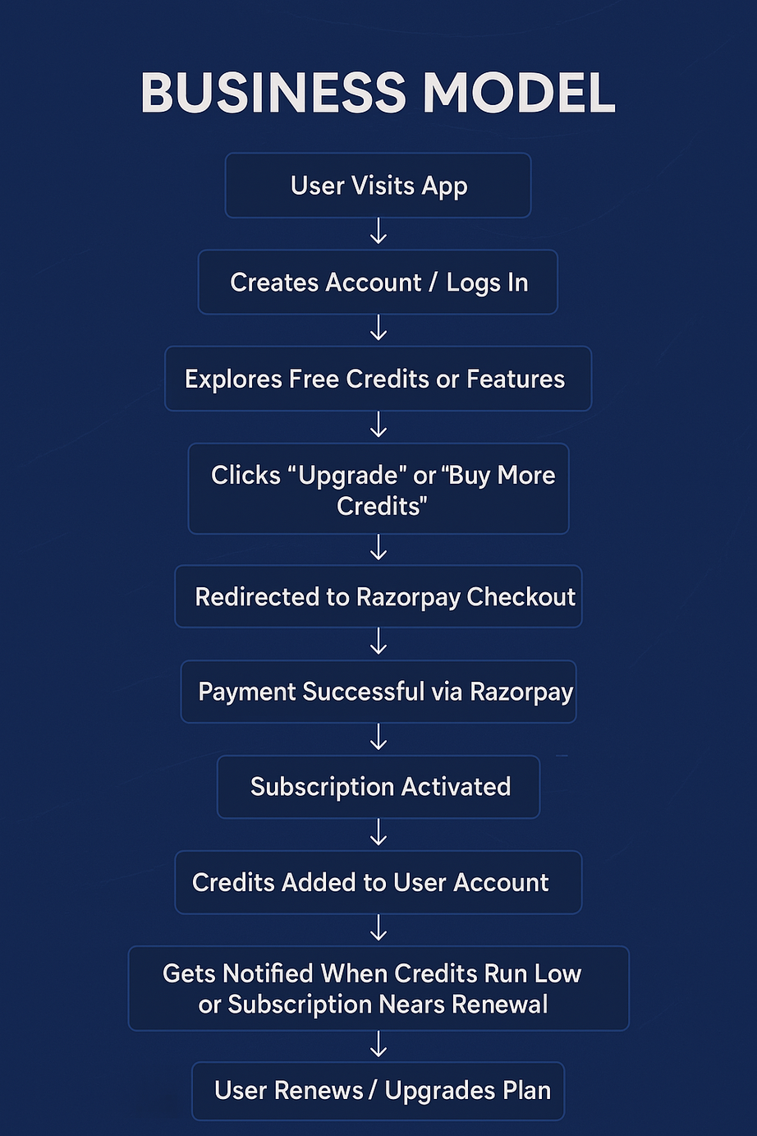
Subscription + Credit System with Razorpay
User Visits App
A user discovers and opens the application via website, app store, or direct
link.
Creates Account / Logs In
The user either registers for a new account or logs in with existing credentials.
Explores Free Credits or Features
Once logged in, the user accesses the platform with limited free credits or
trials to experience the features.
Clicks “Upgrade” or “Buy More Credits”
Interested in using premium features or needing more credits, the user selects
a paid plan.
Redirected to Razorpay Checkout
The user is seamlessly redirected to Razorpay's secure payment gateway.
Payment Successful via Razorpay
After completing the transaction, Razorpay confirms the successful payment.
Subscription Activated
The backend listens to Razorpay webhooks and activates the chosen
subscription for the user.
Credits Added to User Account
The platform automatically adds the appropriate number of credits to the
user’s account based on their subscription.
Gets Notified When Credits Run Low or Subscription Nears Renewal
The user is notified via email or in-app alerts when their credits are about to
run out or their plan is nearing expiry.
User Renews / Upgrades Plan
The user is given the option to renew the same plan or upgrade to a higher-tier subscription.

Slide 6
Thankyou !!!

